Slide 1

AI – Powered Personalized Learning System
First Review Presentation
Team Members :
Bhuvan Sai (24623138)
Sriram. R (24623128)
Ilyas Ahamed (24623148)
Guide :
Ms. S.M Sowmiya

Slide 2
Introduction
Traditional learning systems often rely on a generalized learning model, which may not address the individual needs and academic performance of each student. This project presents an AI-powered personalized learning system that integrates RAG, multimodal document processing, LLMs, and student performance analysis.
Uploads and processes study materials and test papers
Uses OCR and document extraction to process content
Provides context-aware AI assistance using retrieved study material
Identifies strengths and weaknesses through diagnostic tests
Provides personalized study recommendations based on performance

Slide 3
Why This System Is Needed
Students are increasingly using digital notes, presentations, question papers, and online resources in their studies. However, these resources are frequently disassociated from their particular academic success. Existing learning technologies can deliver information or answer questions, but they may not comprehend what a certain student has studied, where they struggle, or how their performance changes across different areas.
Context-Aware Learning
Generic AI assistants are not necessarily grounded in the student's own study material. This can make it difficult to ensure that responses are relevant to the content being studied.
Personalized Performance Analysis
A student's overall test score does not provide enough information about their learning gaps. Question-wise and topic-wise performance can reveal which concepts require additional attention.
Adaptive Assessment
Conventional assessments generally follow a fixed structure. Students would benefit from assessments and practice questions that can be adjusted according to their demonstrated strengths and weaknesses.

Slide 4
Existing Approaches & Their Limitations
Learning Management Systems, document-based study tools, and general-purpose AI assistants are all available for learning help. These approaches, however, often address only specific aspects of the learning process rather than integrating them into a tailored approach.
Traditional Learning Platforms
Provide study materials, assignments and predefined assessments.
Limitation:
They generally have limited understanding of an individual student's topic-level strengths and weaknesses.
General-Purpose AI Assistants
Can explain concepts, answer questions and generate study content.
Limitation:
Their responses are not necessarily grounded in the student's uploaded curriculum or study material, and they do not inherently maintain a student's academic performance profile.
Document-Based AI Tools
Allow users to upload documents and ask questions about their content.
Limitation:
They primarily focus on information retrieval and question answering rather than connecting document knowledge with test performance and personalized assessment.

Slide 5
Base Paper
AI-Powered System to Facilitate Personalized Adaptive Learning in Digital Transformation
Source: MDPI
Link : https://www.mdpi.com/2076-3417/15/9/4989
The reference paper presents a multimodal study-assistance system that combines document processing, OCR, Retrieval-Augmented Generation and Large Language Models to allow students to interact with their educational materials.
Multimodal Document Processing
The system can work with different forms of educational content, including textual documents and image-based material.
OCR-Based Information Extraction
Text contained within images can be extracted and incorporated into the learning process.
Retrieval-Augmented Generation
Relevant information is retrieved from the processed documents and supplied to the language model before generating an answer.
AI-Based Study Assistance
The system enables students to interact with their learning material through AI-generated responses and study-oriented functionality.

Slide 6
Literature Survey
S.NO | Study | Key Limitation | Our Project | Link
1 | Mladenov et al. (2024) – Personalized Learning Support through RAG | RAG-based learning support was explored mainly as a feasibility study, with limited personalization and adaptation. | Uses diagnostic performance and topic-level weaknesses to personalize study recommendations. | aclanthology.org/2024.swisstext-1.12
2 | Li et al. (2025) – RAG for Educational Application: A Systematic Survey | Identifies challenges including hallucination, computational cost, incomplete retrieval and limited multimodal support. | Combines RAG with multimodal document processing, local LLM deployment and student-specific material retrieval. | https://www.sciencedirect.com/science/article/pii/S2666920X25000578
3 | Nguyen (2026) – Personalized AI Education with Context-Aware RAG | Personalization is primarily based on historical academic grades and focuses on adapting response complexity. | Uses diagnostic tests, topic-wise scores and learning weaknesses to drive personalized study assistance. | https://onlinelibrary.wiley.com/doi/10.1002/cae.70153
4 | Kurdi et al. (2020) – Automatic Question Generation for Educational Purposes | Existing AQG research showed limited control over question difficulty and informative feedback. | Generates diagnostic assessments from the student's own study material and analyzes performance by topic. | https://link.springer.com/article/10.1007/s40593-019-00186-y
5 | Nellipudi & Patel (2026) – Reliable Multimodal AI for Study Material Generation | Multimodal systems face OCR/ASR noise, incomplete extraction of STEM content and hallucination risks. | Supports multiple document formats + OCR, retrieves relevant material through RAG, and provides context-aware AI assistance. | https://www.ijisae.org/index.php/IJISAE/article/view/8165

Slide 7

System Architecture

Slide 8
Software Requirements
OS: Windows 10/11
Languages: Python, JavaScript, HTML, CSS
IDE: Visual Studio Code, Any of your choice
LLM: Ollama (Local LLM)
RAG: LangChain
Vector Database: ChromaDB
OCR: EasyOCR
Document Processing: PyMuPDF, python-docx, python-pptx
Application Framework: PyWebView
Supporting Libraries: OpenCV, Pillow, NumPy, Requests
Internet: Required for external learning resources and initial model setup

Slide 9
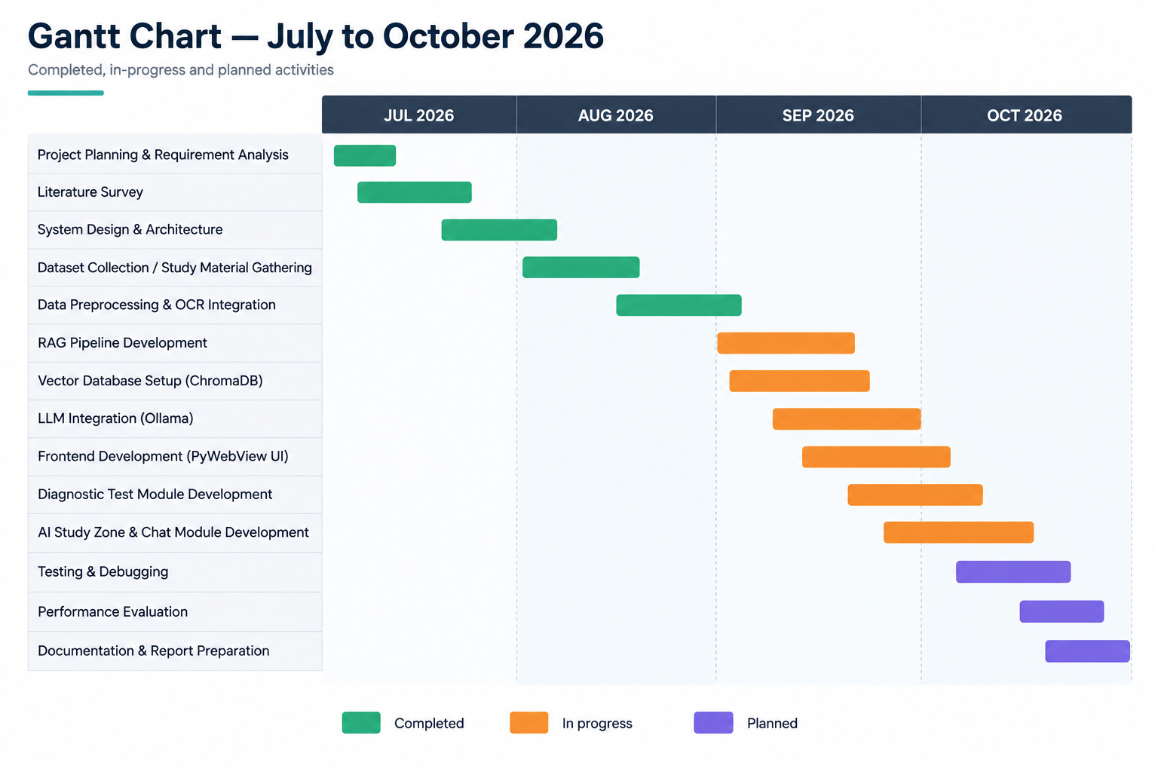
Gantt Chart

Slide 10
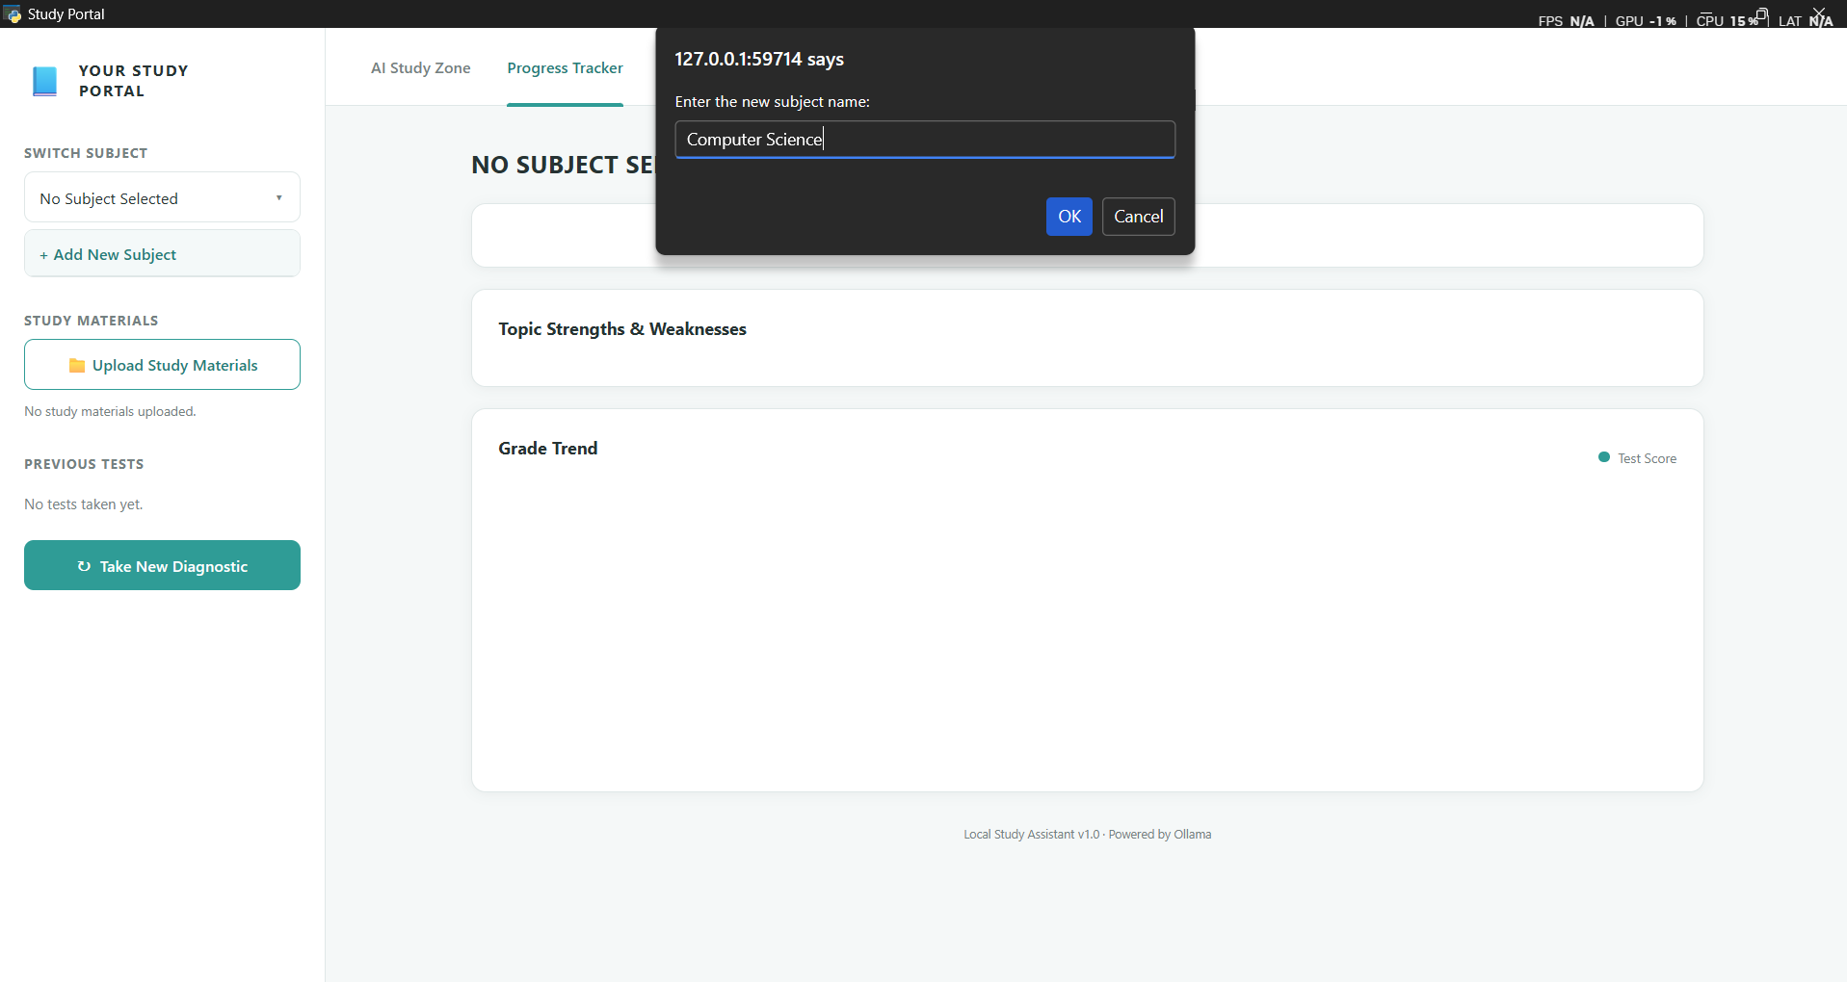
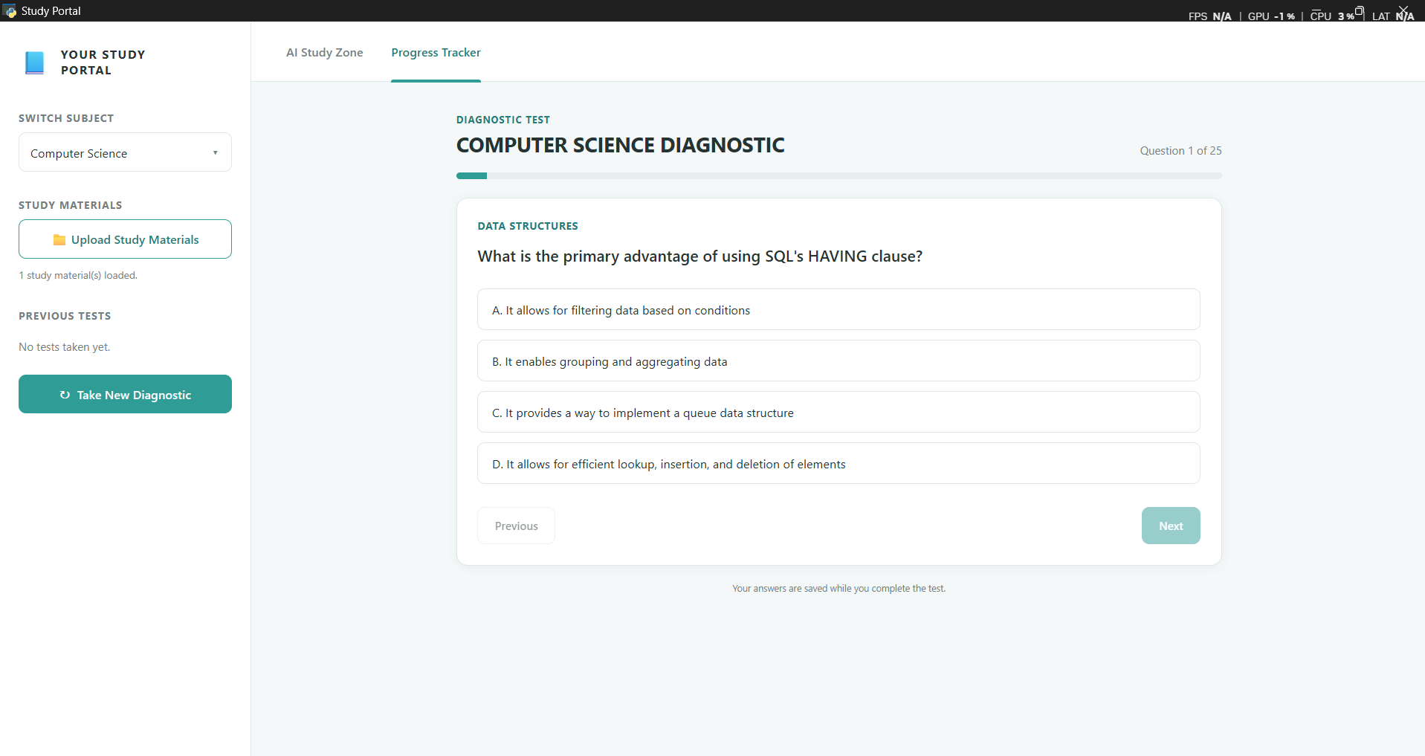
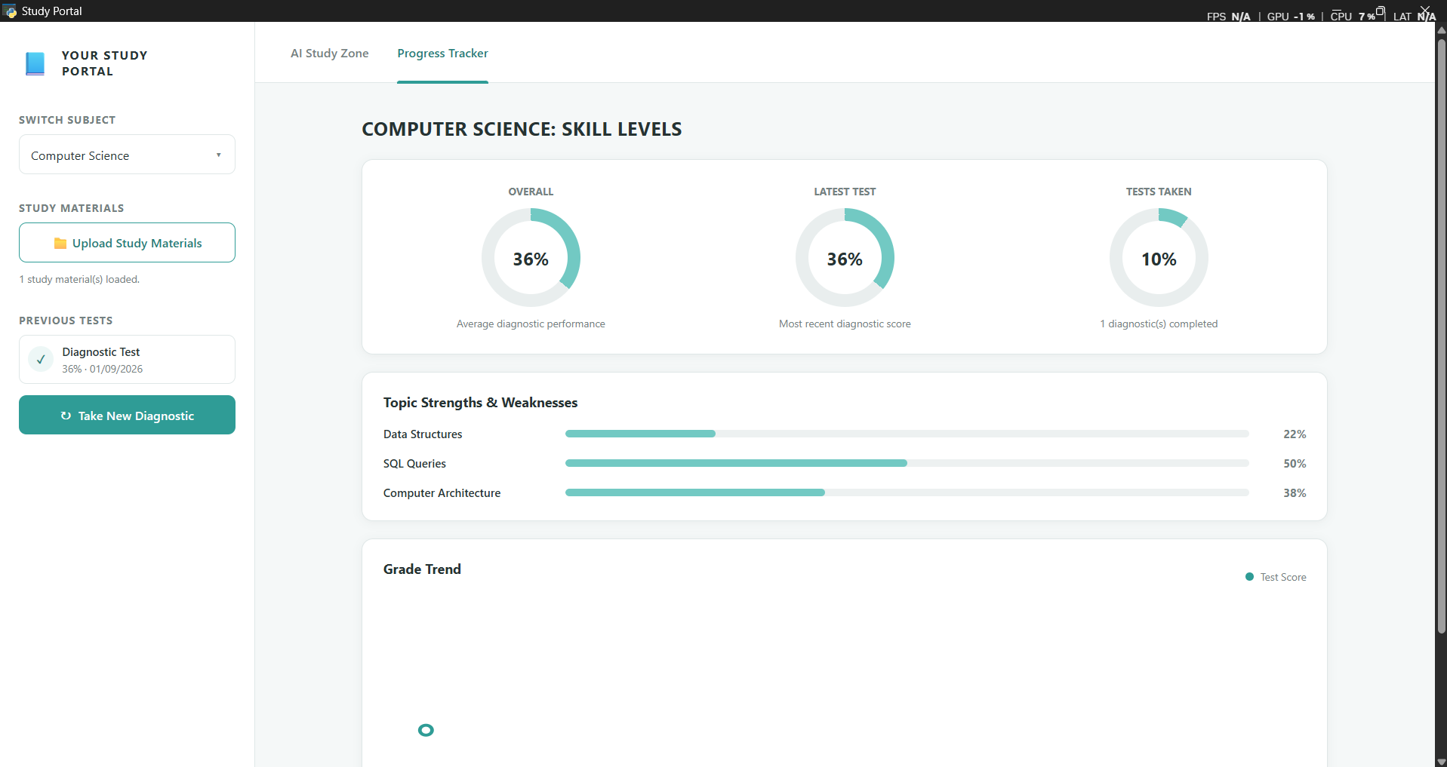
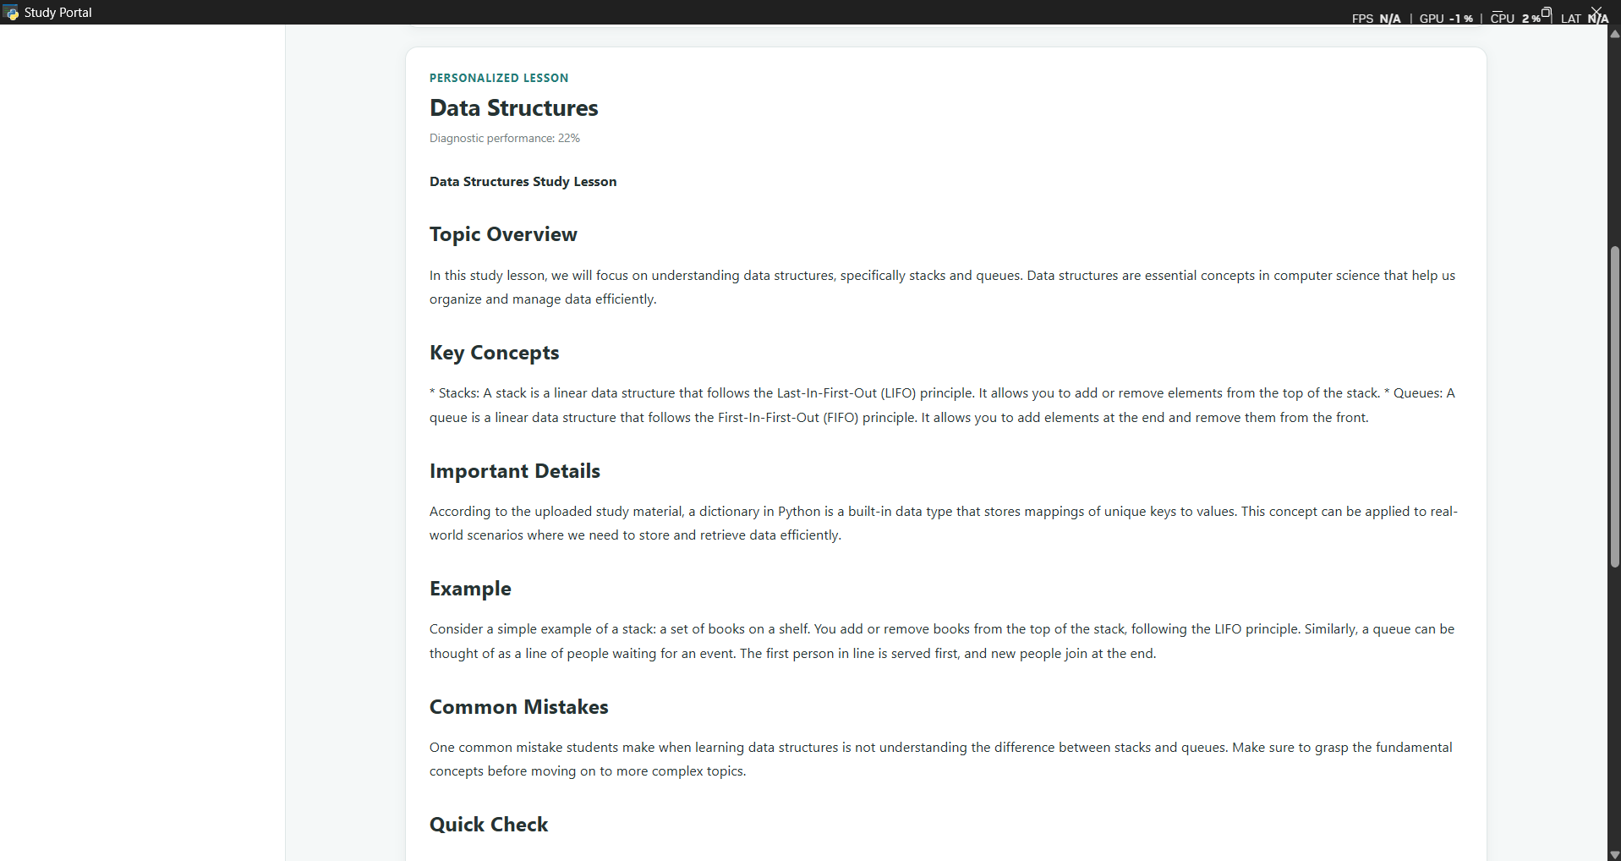
Program Output

